Slide 1
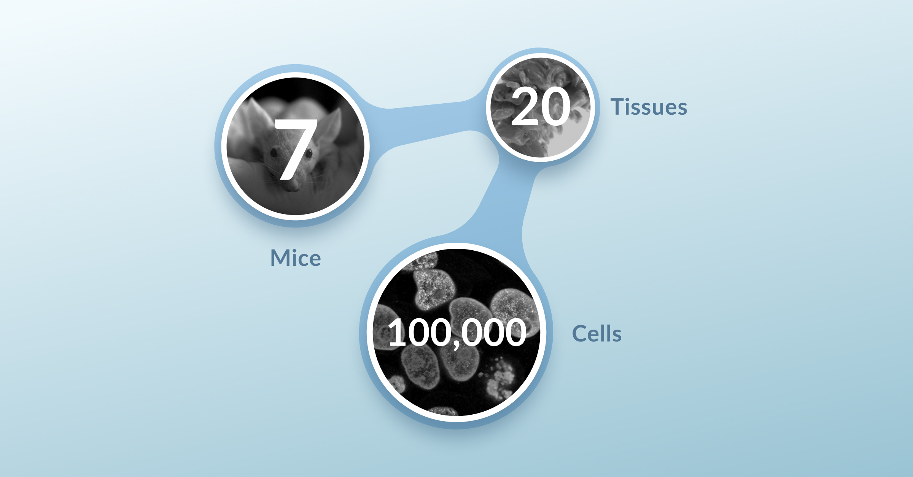

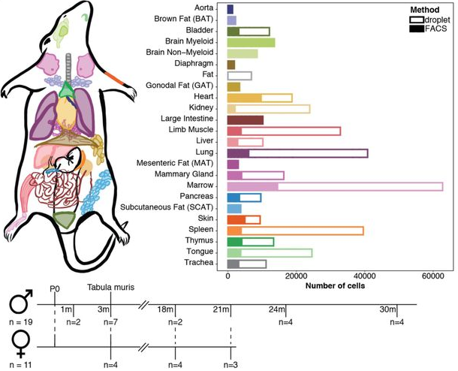
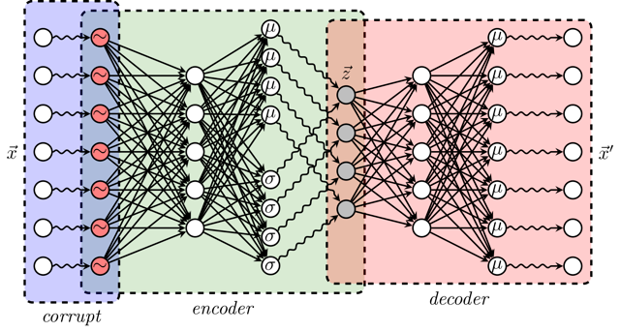
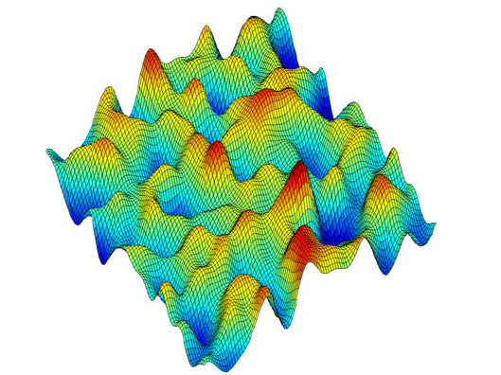
Group Project
Briefly describe your dataset
https://tabula-muris.ds.czbiohub.org/
What is your main computational tools for analyzing this dataset?
What is the principal goal of a VAE? What can it achieve?
Oultine at a high level the goals of your project
Make sure that you mention the subtasks that were
specific to your group.

Slide 2
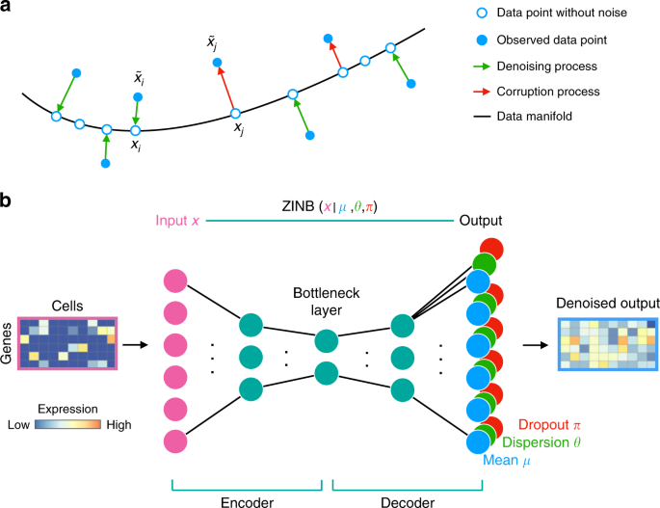
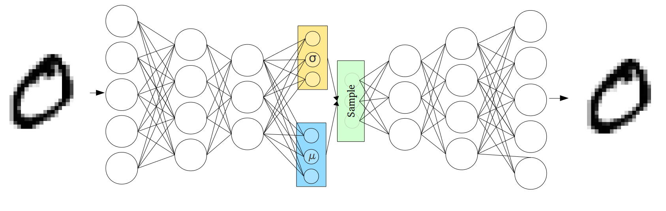
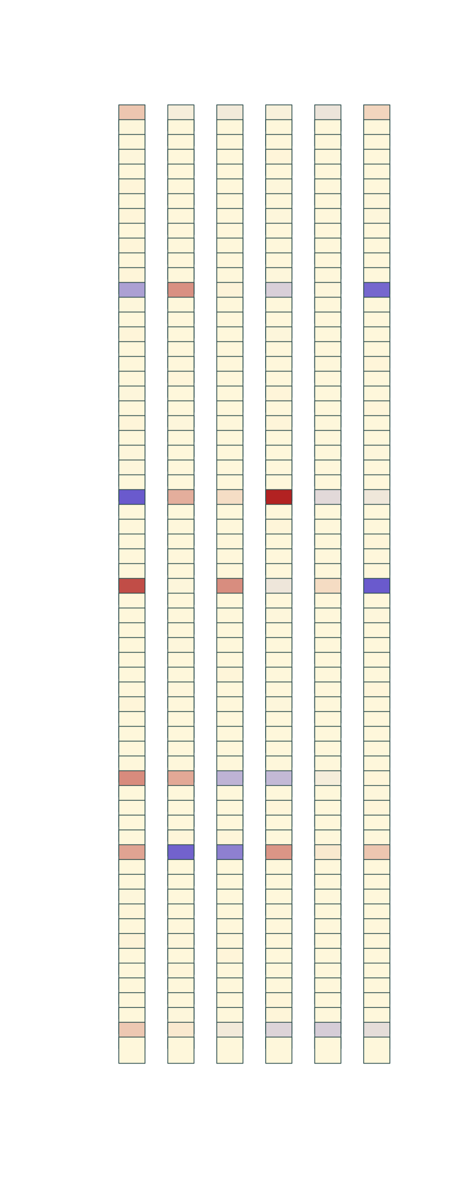
Group Project
Describe your model architecture
Describe your dataset split, holdout datasets
Summarize any observations you made when experimenting with hyperparameters/
architectural choices. Are there trade-offs with some of these choices?
Show training curves
Gene Space
Gene Space
Latent Encoding

Slide 3
Group Project
How did you evaluate your model?
Which sanity check plots do you consider most important and why?
What are the take-away messages of (some of) these plots?
Is there something you would improve on?
Maybe you can think of some other evaluation plots / model assessment metrics?

Slide 4
Group Project
How does the latent space summarize your model?
Could it be used for visualization?
Do the different latent dimensions correspond to particular attributes of the data?
Is there a way to map genes to specific latent nodes?

Slide 5
Group Project
Describe your imputation/ denoising task.
What type of corruption did you enforce?
How did the model perform?
Was performance different on different subsets of the data?
e.g FACS/droplet, training set/validatation set/holdback dataset?

Slide 6
Group Project
Describe the strategy for batch correction
What are some important points to keep in mind when using latent arithmetic?
(think of the possible ways variance can be confounded when trying to summarize a source of variance as a latent vector).
Does the strategy do a reasonably good job in correcting for batch?
In case you tried different strategies in terms of applying the latent arithmetic which
performed best and why?

Slide 7
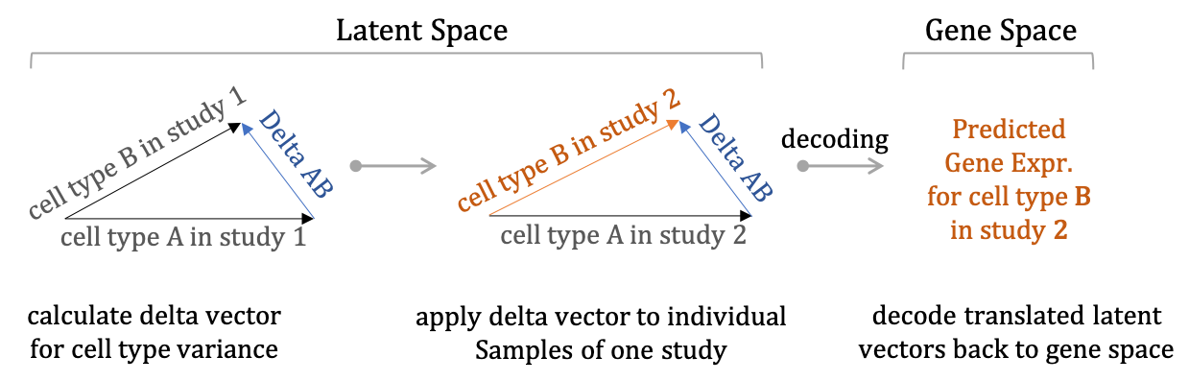
Group Project
Describe the out-of-sample prediction task
What are you trying to predict?
How in general can that be of value?
Does the strategy do a reasonably good job in predicting missing samples?
Again, in case you tried different strategies in terms of applying the latent arithmetic which
performed best and why?

Slide 8
Group Project
Summarize your observations.
What did you find more challenging/interesting?
How does it fit/compare with analysis pipelines you have used?
Are you thinking in applying it in a particular way in your own research?

